Slide 1
Detection of Artificial Intelligence Generated Images
Riski Adianto
Saira Faiz
Colby Jamieson
Karl Yazigi

Slide 2
Introduction
Sentence:
Sub-sentence

Slide 3
Objective & Scope
Ideas for motivation for the project would be something along the lines of:
To explore weaknesses in AI generated images
Or/and to explore whether Ai generated images leave detectable differences

Slide 4
Related Work
Sentence:
Sub-sentence

Slide 5
Methodology
Probably include Theory/Background on Convolutional neural networks as well as how dall-e works:
Sub-sentence

Slide 6
Data Collection
Dall-e images were scraped from the website: 'https://dalle2.gallery/#search-random’:
Human made images were scraped from google using different search keywords, you can find the keywords used for this in the data scrape.ipynb file saved as a list “categories”.
Images are various styles of art (cartoon, oil painting, digital art, anime etc) and photorealistic images (humans, animals, outdoors etc) for both Dall-e and human made images
Images were left in RGB format as an array. So an array of shape(255,245,3). Values were scaled to be between 0->1
Images cropped to avoid fitting to watermarks

Slide 7
Model Details
Convolutional Neural Network (CNN) to classify images into two categories: "Human" and "DALLE-2".
Two sets of convolutional layers, each followed by max pooling, and two fully connected (dense) layers with ReLU activation function and a final output layer with sigmoid activation function.
Notes:
Used a convolutional network for the model. Shape and size of the neural network can be found on the train-results.ipynb file:
Sub-sentence

Slide 8
Training & Testing
Training is performed for 10 epochs, with each epoch using a different batch of data from 1800 images (split evenly between human and DALLE-2 generated images)
Testing performed on batch of 930 DALLE-2 and 650 human generated images data
“Adam” optimizer is used with a learning rate of 0.00005
Binary cross-entropy loss function is used to calculate the loss during training
Notes:
Model was trained for 10 epochs on 5 batches of 1800 images. So a total of 9000 images were used to train the model split equally between DALL-E generated and Human made images:
Sub-sentence
Test batch was 1580 images 930 of which were dall-e generated and 650 human made:
Sub-sentence

Slide 9
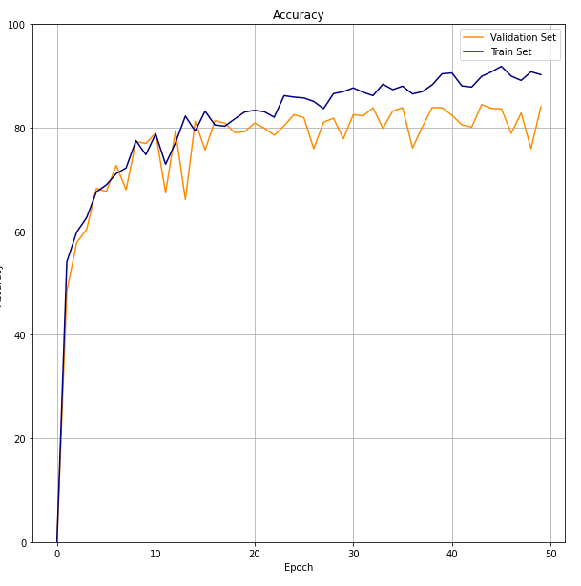
Results: Accuracy
Optimal validation set accuracy ~80% around 20 epochs
Notes:
The 50 epochs on the graph for accuracy are because of the 10 epochs for 5 batches (10x5 = 50):
I’ve made graphs of accuracy, confusion matrix (for fp tp fn and tn rates), and the ROC and AUC curve
Sub-sentence

Slide 10
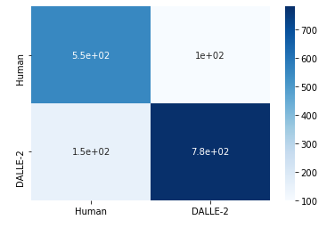
Results: Confusion Matrix
Confusion Matrix
100 incorrectly labeled DALLE-2 images
150 incorrectly labeled human-made images
Predicted
Actual
Notes:
The 50 epochs on the graph for accuracy are because of the 10 epochs for 5 batches (10x5 = 50):
I’ve made graphs of accuracy, confusion matrix (for fp tp fn and tn rates), and the ROC and AUC curve
Sub-sentence

Slide 11
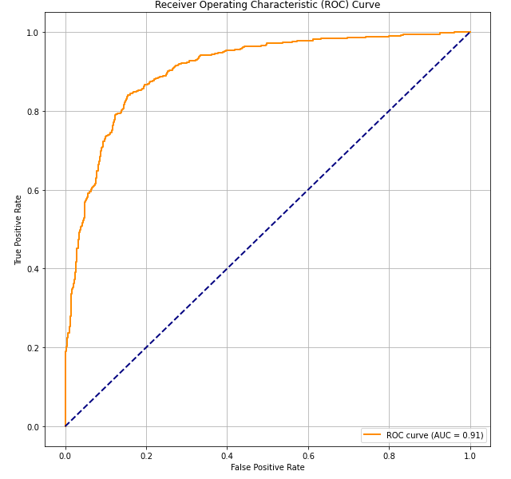
Results: Confusion Matrix
Area under curve: 0.91
High performing sensitivity and specificity trade-off
Relatively high true positive and low false positive rate
Notes:
The 50 epochs on the graph for accuracy are because of the 10 epochs for 5 batches (10x5 = 50):
I’ve made graphs of accuracy, confusion matrix (for fp tp fn and tn rates), and the ROC and AUC curve
Sub-sentence

Slide 12
Discussion
Ideas:
Scalability
Limitations
Future work
Importance of work and usage

Slide 13
Summary
Sentence:
Sub-sentence

Slide 14

Thank You

